Slide 1
IMDb Sentiment Analysis Project
Using Logistic Regression, LSTM, and Q-Learning Model Selector
Prepared By: MUGASHA BLAISE BRADLEY
REG NO: 2024-M132-23976

Slide 2
Project Overview
NLP preprocessing on 50,000 IMDb reviews
Train ML (Logistic Regression) and DL (LSTM) models
Reinforcement Learning to select best model per review
Compare accuracy and interpret results

Slide 3
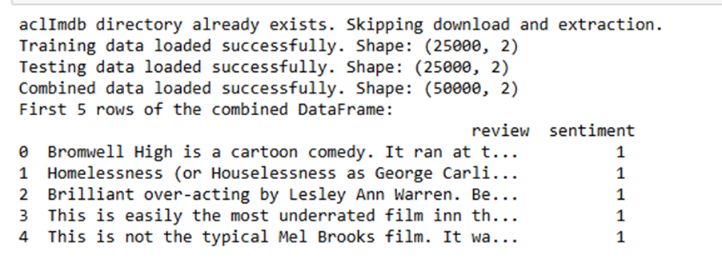
Dataset Summary
50,000 movie reviews (balanced 25k positive / 25k negative)
Contains long/short reviews, HTML tags, noise
Used for binary sentiment classification

Slide 4
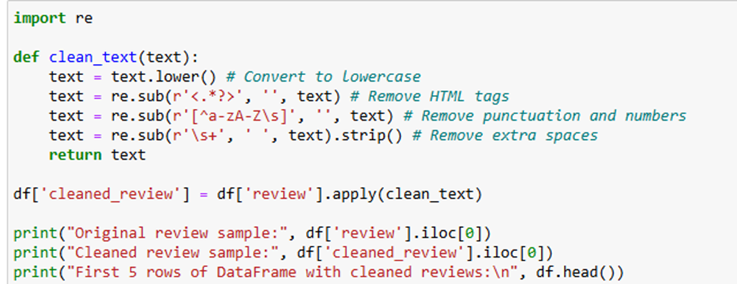
Text Cleaning Steps

Slide 5
Feature Engineering
TF‑IDF: 10,000 features → matrix (50,000 × 10,000)
Tokenizer vocab: 214,621 unique words
Average review length: ~225 tokens
Padded sequences: length 439 → matrix (50,000 × 439)

Slide 6
Logistic Regression Model
Input: TF‑IDF vectors
Accuracy: 0.8916
Precision: 0.8838 | Recall: 0.9018 | F1: 0.8927
Strong performance on short/sentiment-heavy reviews

Slide 7
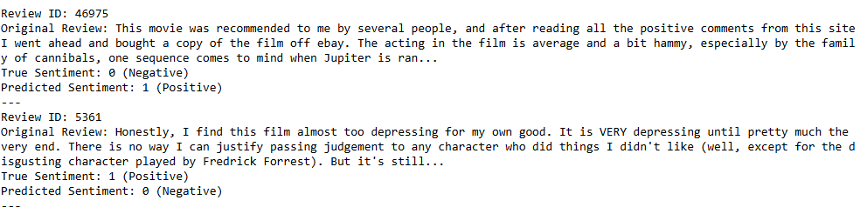
Logistic Regression – Misclassifications
Some positive reviews misclassified as negative
Some negative reviews misclassified as positive
Often occurs with sarcasm, nuanced writing, or long text

Slide 8
LSTM Deep Learning Model
Embedding(10k, 128D) → LSTM(128 units) → Dense(sigmoid)
Accuracy: 0.8448
Precision: 0.8107 | Recall: 0.8996 | F1: 0.8529
Better at long-term dependencies but needs more training

Slide 9
LSTM – Misclassifications
Fails mostly on short reviews lacking sequence structure
Some long reviews predicted incorrectly when sentiment subtle
Better performance when context matters

Slide 10
ML vs DL Comparison
Logistic Regression outperformed LSTM in this dataset
LR captures explicit sentiment words clearly
LSTM captures order/context but undertrained
Both models have complementary strengths

Slide 11
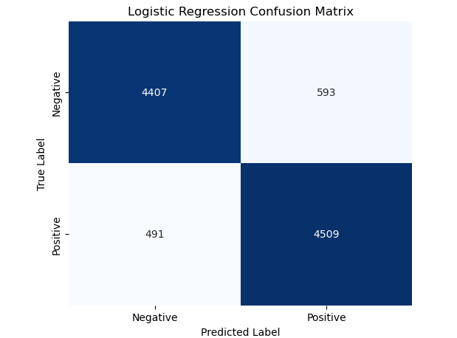
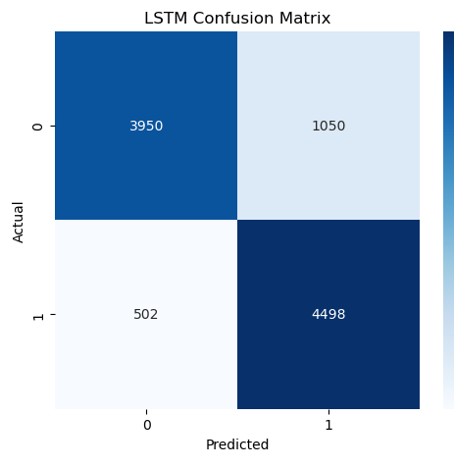
Confusion Matrix

Slide 12
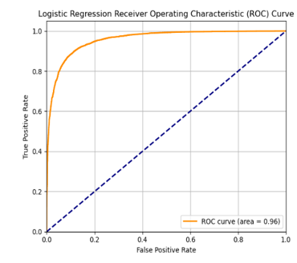
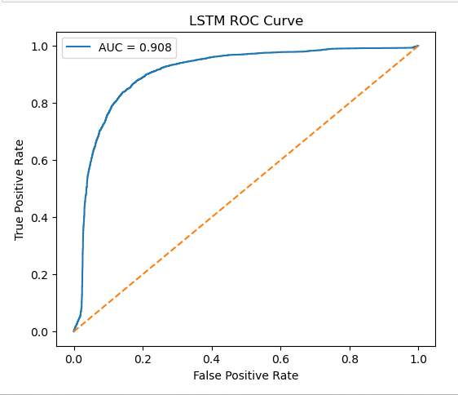
ROC Curve

Slide 13
Reinforcement Learning Setup
State: [ML prob, DL prob, confidence diff, review length]
Actions: 0 = use ML, 1 = use DL
Reward: +10 correct, −5 incorrect
Total states: 2835 | Trained for 1000 episodes

Slide 14
RL Model Selector Results
RL Accuracy: 0.8962 (best overall)
RL beats both LR (0.8916) and LSTM (0.8448)
Learned when each model performs better
Reward curve improved across episodes

Slide 15
Model Behavior Interpretation
RL chooses ML for short/keyword-based reviews
RL chooses LSTM for long/context-heavy reviews
RL reduces misclassification by switching models
Shows hybrid systems outperform single models

Slide 16
Misclassification Insights
LR struggles with sarcasm & complex narrative
LSTM struggles with short reviews lacking context
RL reduces both types by choosing smarter per-review

Slide 17
Improvements & Future Work
Use Bi‑LSTM or GRU networks
Use pretrained embeddings (GloVe, BERT)
Upgrade RL to Deep Q‑Network (DQN)
Tune LSTM training (more epochs, dropout adjustments)

